Slide 1
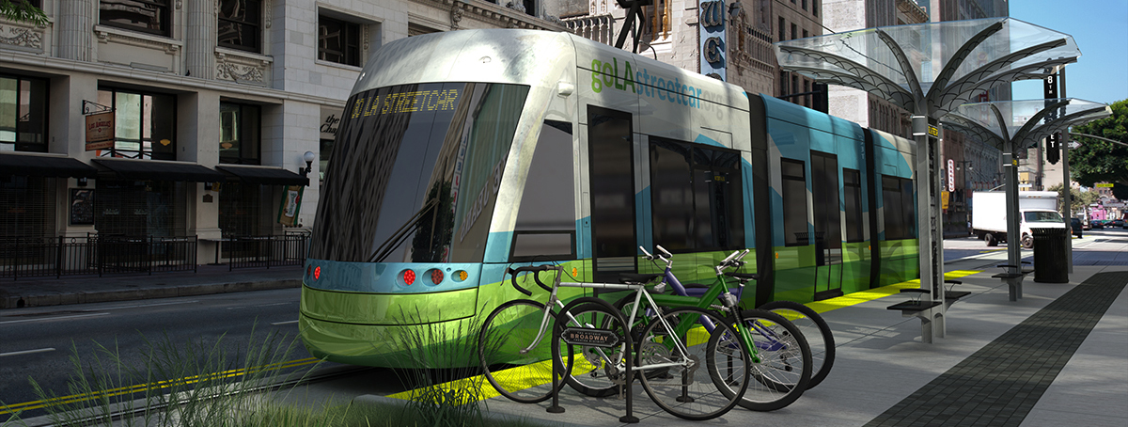
THE Los Angeles Streetcar
Community Update
June 30th, 2016

Slide 2
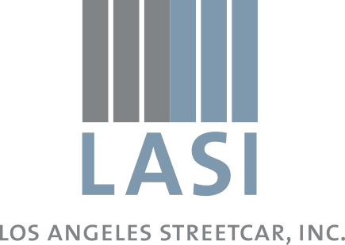
About LA Streetcar, Inc. (LASI)
Created in 2009, modeled after Portland Streetcar, Inc.
Role has evolved from “project leader” to “partnership and advocacy” with City of LA
Manage CRA grant, 30% design consultants
Partners:
City—Councilmember Huizar (CD14), BOE, DOT, CAO
Others—Metro, FTA, CRA/LA
Consultants—AECOM, HDR, Mott MacDonald

Slide 3
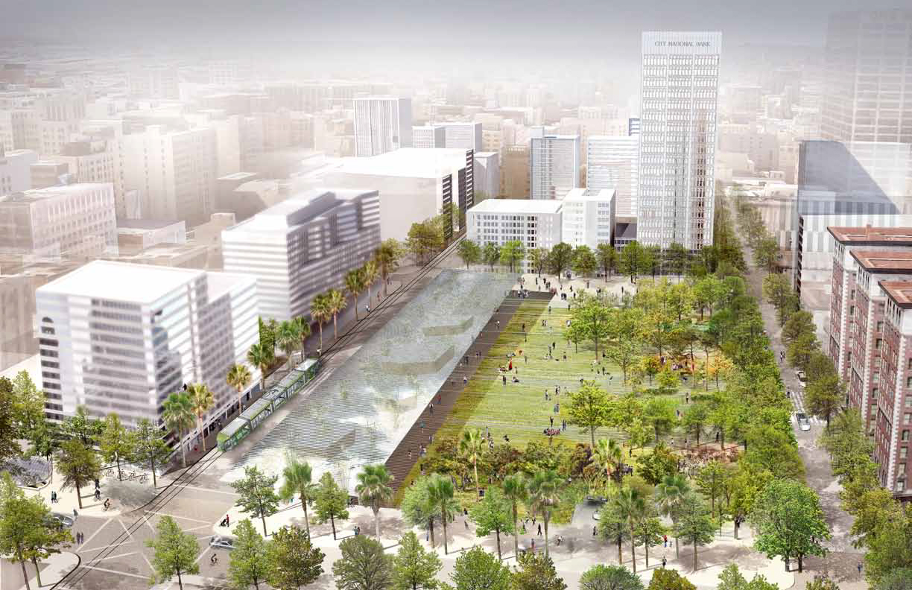
Streetcar 101
Smaller than light-rail; street-running vehicles
Quiet, sustainable, accessible, and high-capacity
First/last-mile connections to regional transit & activity centers
Catalyzes and complements complete streets investments (Broadway, Pershing Square, etc.)
Promotes highest and best use of adjacent land

Slide 4
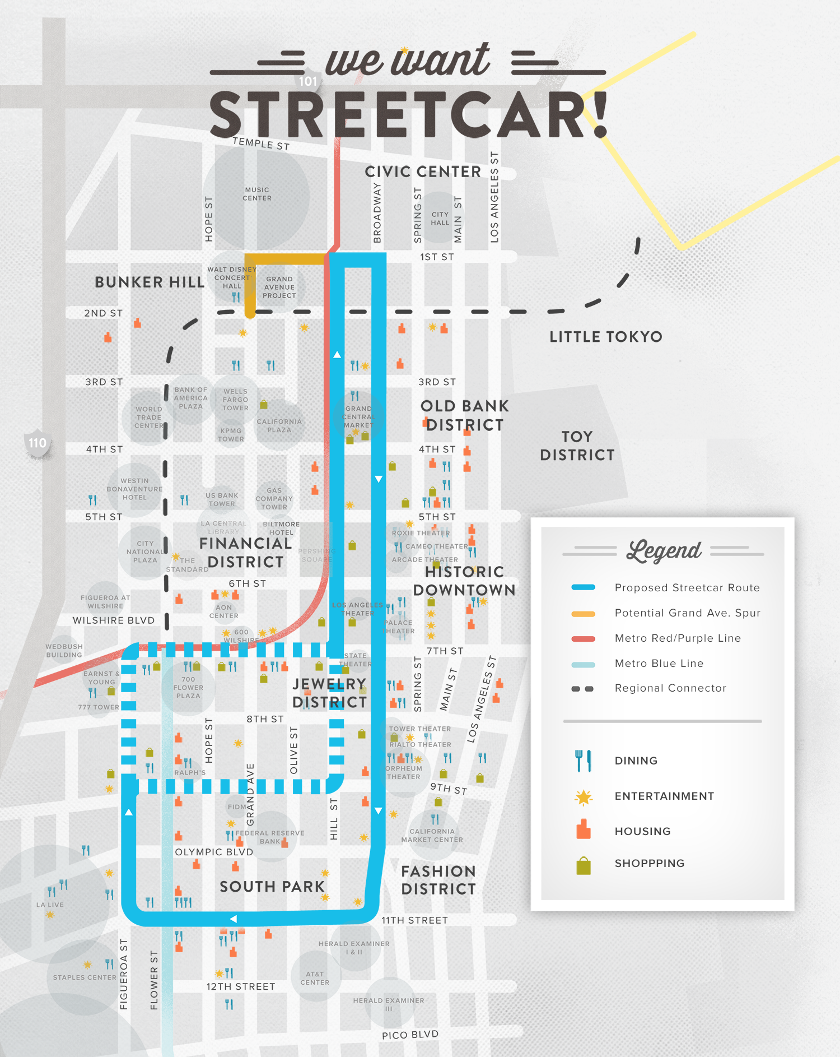
Project summary
3.8-mile loop
7th / 9th Street alternatives
Option for Grand Ave extension
Frequent service
7-minute peak hour headways
10-minute and 15-minute rest of day
Up to 6,000 daily riders (2020)
Connects major activity centers:
Staples/LA Live/Convention Center, Grand Park/Civic Center, Historic Broadway, Fashion District, etc.

Slide 5
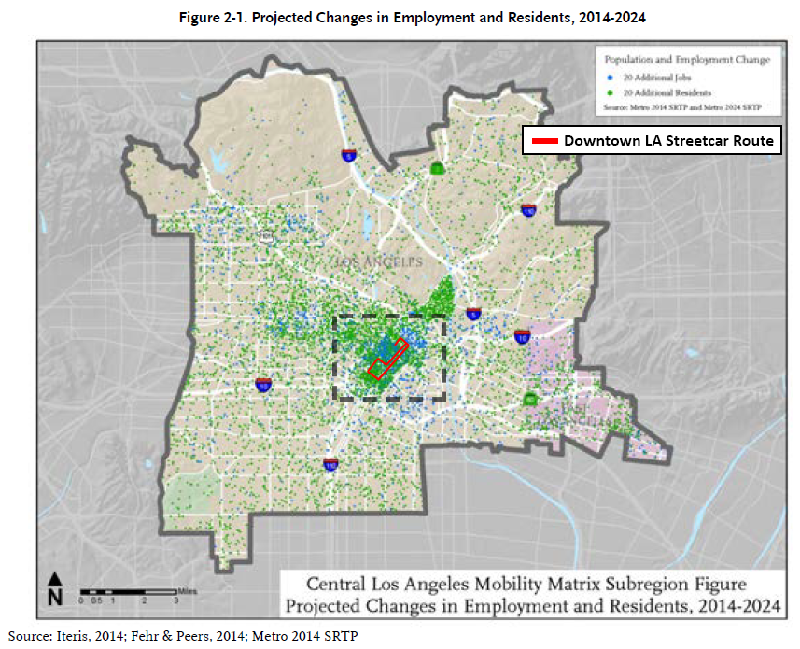
Why Downtown?
4 of 14
Center of regional transit network
4 Metro Rail lines
Dozens of Metro Bus lines
DASH, Commuter Express, BBB, etc.
Large transit-dependent population
Most growth in Central LA will be in DTLA in the coming decade
Geographical area too large to access everything on foot

Slide 6
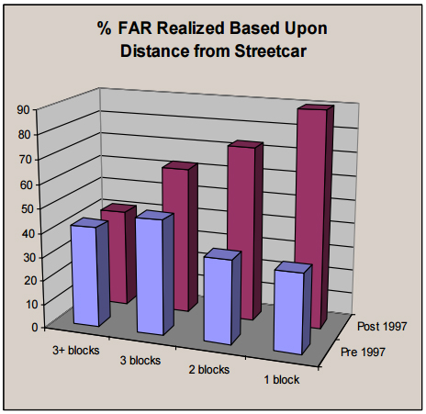
Economic impact
5 of 14
Major impact on local economy
20,000 jobs (constr. and permanent)
$1.44 billion in additional development
4,500 housing units
231,000 SF office space
$250+ million in new tax revenues
All above and beyond what would be built/invested without streetcar
Land use impacts of Portland Streetcar. Source: ED Hovee & Company, Portland Streetcar Development Impacts, 2005.

Slide 7
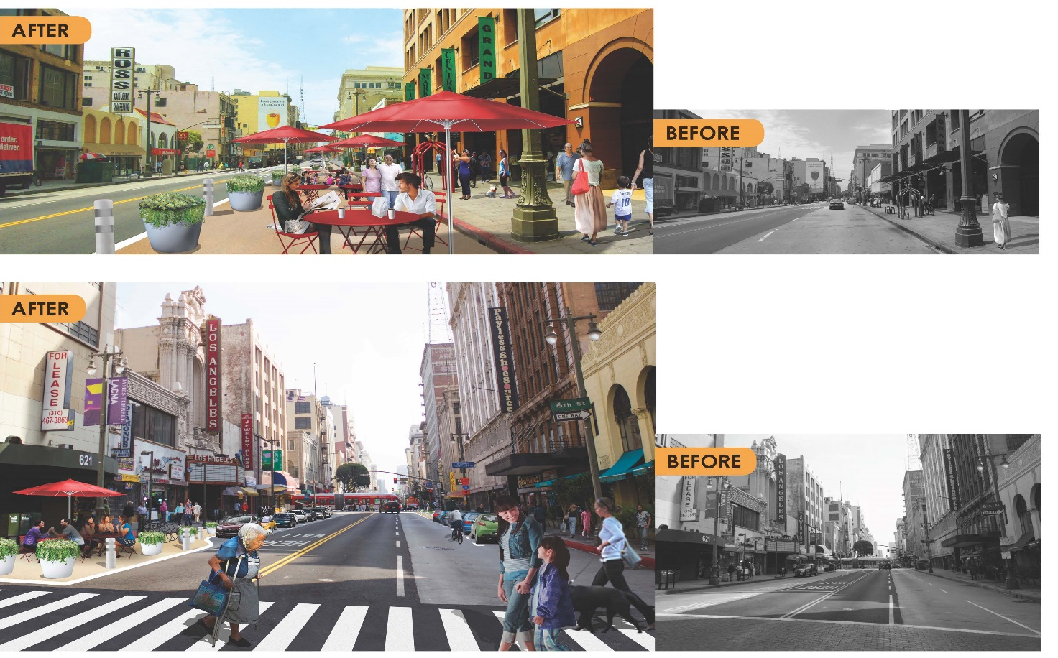
Partners
6 of 14
Broadway Streetscape Master Plan
MyFigueroa! (Figueroa, 11th Street)
7th Street Improvements (Wilshire Grand)

Slide 8
Background
2006: Feasibility Study (CRA/City)
2009: LA Streetcar, Inc. established
2012: Alternatives Analysis (Metro), $85M Community Facilities District vote
2013: City commits $295M to operate streetcar for 30 years, hires Project Manager
2014: Enter FTA Project Development
2015: Independent Cost Estimate (AECOM)
Upcoming for 2016: Release draft EIR (June), complete P3 financial analysis (July/August), complete 30% design (August/September), Measure R2 vote (November)

Slide 9
Draft EIR
5 project alternatives:
No-build; 7th or 9th; with/without Grand Ave extension
Published June 24th, 2016
Impact categories:
Traffic, noise and vibration, aesthetics, greenhouse gases and air quality, energy, bicycle safety, land use, cultural + historic resources, etc.
3 maintenance and storage facility sites under consideration

Slide 10
Final EIR — NEPA/EA
Important dates for Final EIR:
Complete by September/October
Presented to City Council between October and November
Will include recommendation for alignment and MSF location
Federal NEPA environmental analysis performed separately
Expected to be complete in April 2017
Final design would follow

Slide 11
Preliminary Engineering
15% and 30% design phases
Track alignment
Roadway / drainage
Power systems
Traffic modeling (VISSIM)
Station design and locations
Maintenance and storage facility
Important dates
15% submittal: April 13th, 2016
30% submittal + cost estimate: August 31st, 2016

Slide 12
engineering Goals
Project capital budget: < $250M
Opportunities: utilities, vehicles, roadway, MSF, power systems, public-private partnerships
Average speak in PM peak: 6 MPH
VISSIM modeling / analysis
Downstream impacts on ridership, revenues, capital and operations cost

Slide 13
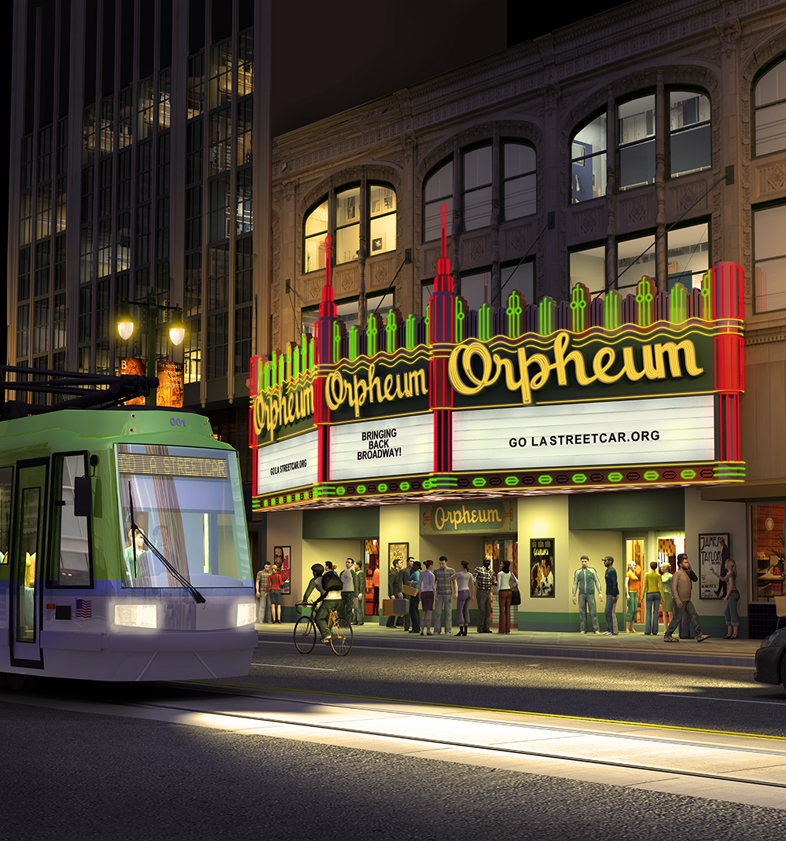
Design challenges
Maintenance and Storage Facility (MSF): Location and physical constraints
Vehicles: Buy America and CPUC
Rail: block, T, girder
Roadway: street crown, streetscape coordination

Slide 14
Financial plan
Current cost estimate: $282 million
Proposed/potential funding components:
Community Facilities District: Up to $85M
FTA Small Starts: up to $100M
Metro ballot measure: $200M
P3: currently under analysis (will look at cost-cutting, revenue-increasing, delivery methods, etc.)
2016 will be an important year for hammering out details of financial plan

Slide 15
Project timeline
2016: Complete EIR, preliminary engineering, P3 analysis, Metro vote
2017: Begin final design and vehicle procurement; complete NEPA environmental
2018: Complete final design; begin construction
2019: Continue construction
2020: Complete construction; begin rail/vehicle testing; begin revenue service

Slide 16
LEARN MORE BY VISITING US AT WWW.STREETCAR.LA

